Slide 1
Research Paper Presentation ITM ITMS 528 Securing Big Data: Databases Illinois Institute of Technology
IIT - ITM master year: research paper presentation

Slide 2
Plan
Introduction
I – Access control: Identification
II – Backups
III – Encryption
Conclusion

Slide 3
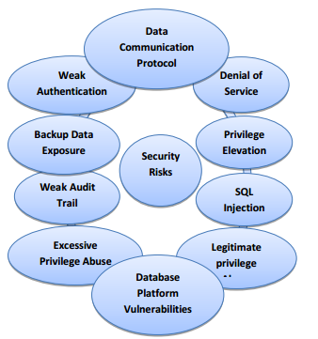
Introduction
Topic: Securing Big Data: Databases
Thesis: Learn more about three main types of information security: access control, backups and encryption.
Access control: Identification
Backups
Encryption

Slide 4

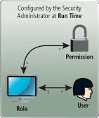
Access control: Identification
What is the definition of an access control?
Physical: limits access to buildings, rooms and physical assets
Logical: access limits connections to computer networks, system files and data.

Slide 5
Difference between authentication and authorization?
Authentication: “process of verifying the identity of a user attempting to access a resource”
Authorization: “process of verifying the user's permission to access a resource”

Slide 6
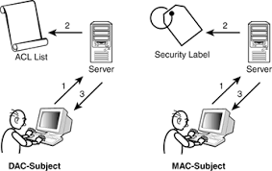
Two main types of access control
Discretionary access control (DAC)
Mandatory access control (MAC)

Slide 7
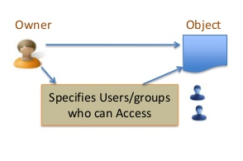
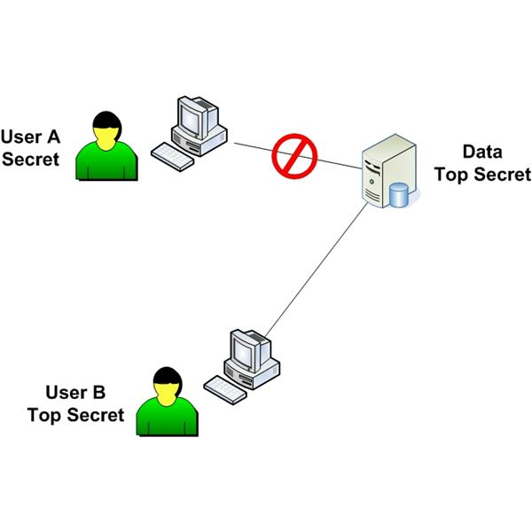
Characteristic of each
DAC:
allows individuals to complete control over any objects
Document owner has the authority to control access of the document
MAC:
gives only the owner of the access controls
MAC is the highest access control that can be provided

Slide 8
MAC vs DAC
DAC
MAC
You decided how you want to protect and share your data
Might set a file private so only group friend can read it
The system decided how the data will be shared
System administrator can restrict propagation

Slide 9
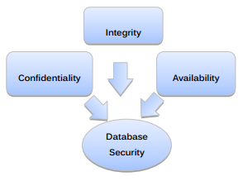
Main security principles of access control
The three main security principles to access control are:
Availability
Integrity
Confidentiality

Slide 10

Backups
What media should I use?
Where will backup be placed?
What should be backed up?
How often should information be saved?
What time of day should backup occur?
What type of backup should be completed?

Slide 11
Definition
General meaning
“copying and archiving of computer data so it may be used to restore the original after a data loss event”
What does database backup mean?
backing up the operational state, architecture and stored data of database software.
creation of a duplicate instance or copy of a database in case the primary database crashes, is corrupted or is lost

Slide 12

What could happen to your data?
The three main threats are:
Natural disasters
Power outages
Lost devices

Slide 13
Why are we using database backups?
backup data exposure is an important threat
take care about this threat
backups on tapes, DVD or any external media are exposed to some risks

Slide 14
How to protect your data?
backed up to tape or disk: “geographically distant location or on the cloud”
encrypt data (see after) => ensure that our data are protected
automatic backups and continuous backups should be automatic
make data easily accessible to users in near real time
the storage side is an important aspect of the information security

Slide 15
Media storage types

Slide 16
Encryption
Definition
“Encryption is the most effective way to achieve data security. To read an encrypted file, you must have access to a secret key or password that enables you to decrypt it.”
“The primary purpose of encryption is to protect the confidentiality of digital data stored on computer systems or transmitted via the Internet or other computer networks.”

Slide 17
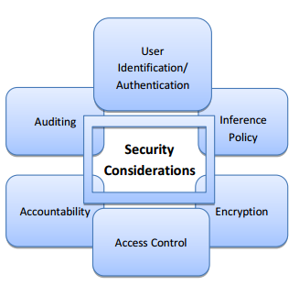
Why are we using encryption?
Lots of organizations have private data on their web servers. And we can assume that those data really need to be protected from attacker or from any introduction by someone.

Slide 18
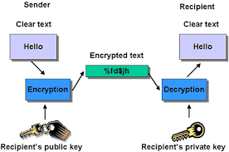
How does encryption work?
three encryption levels where encryption is performed:
storage-level encryption
database-level encryption
application-level encryption
Works with encryption algorithms

Slide 19
Conclusion
We learnt about three main types of information security related to databases:
Access control: Identification
Backups
Encryption

Slide 20

Thank you for listening
Question?

Slide 21
References
[1] - http://searchsecurity.techtarget.com/definition/access-control
[2] - Class ITMS 528 – Database Security – Professor Hosea Lee – Illinois Institute of Technology
[3] - http://www.nortechcontrol.com/access-control/what-is-access-control.aspx
[4]- https://en.wikipedia.org/wiki/Backup#Managing_the_data_repository
[5] - https://secure.backblaze.com/press/Backblaze_Online_Backup_Benefits.pdf
[6] - http://citeseerx.ist.psu.edu/viewdoc/download?doi=10.1.1.258.8172&rep=rep1&type=pdf
[7] - Database Security 1st Edition by Alfred Basta and Melissa Zgola
[8] - https://en.wikipedia.org/wiki/Database_security
[9] - http://resources.infosecinstitute.com/access-control-models-and-methods/
[10] - https://en.wikipedia.org/wiki/Access_control
[11] - https://en.wikipedia.org/wiki/Authentication
[12] - https://en.wikipedia.org/wiki/Encryption
[13] - http://citeseerx.ist.psu.edu/viewdoc/download?doi=10.1.1.414.1729&rep=rep1&type=pdf
[14] - http://www.ijarcsse.com/docs/papers/Volume_3/5_May2013/V3I5-0309.pdf
[15] - http://arxiv.org/ftp/arxiv/papers/1004/1004.4022.pdf
[16] - http://www.engpaper.net/database-security-research-papers.htm
[17] - Gang Chen; Ke Chen; Jinxiang Dong; A Database Encryption Scheme for Enhanced Security and Easy Sharing; Computer Supported Cooperative Work in Design, 2006
[18] - http://citeseerx.ist.psu.edu/viewdoc/summary?doi=10.1.1.258.8172
[19] - Dr. Anwar Pasha Abdul GafoorDeshmukh; Dr. Anwar Pasha Abdul GafoorDeshmukh; Transparent Data Encryption- Solution for Security of Database Contents; (IJACSA) International Journal of Advanced Computer Science and Applications, Vol. 2, No.3, March 2011
[20] - http://resources.infosecinstitute.com/access-control-models-and-methods/

